Slide 1
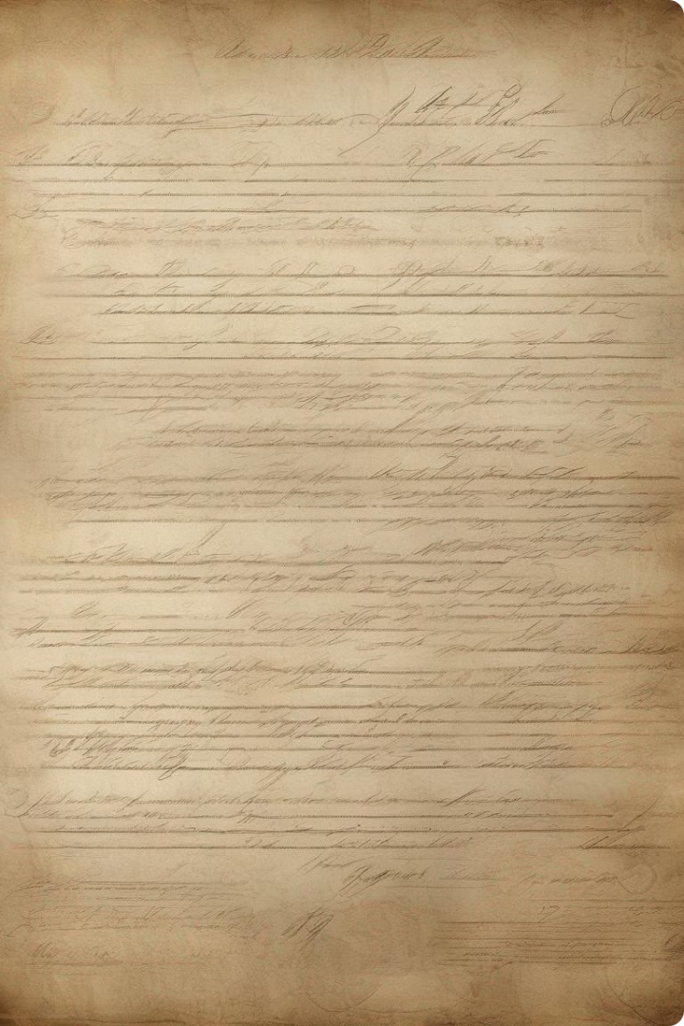
OSINT 2 Group Presentation
A Historical Analysis of Contract Workers from India to Suriname
Group 2: Vishal Mandal, Sanat Rajput, Anmol Bakshi, Nenavat Anil Kumar

Slide 2
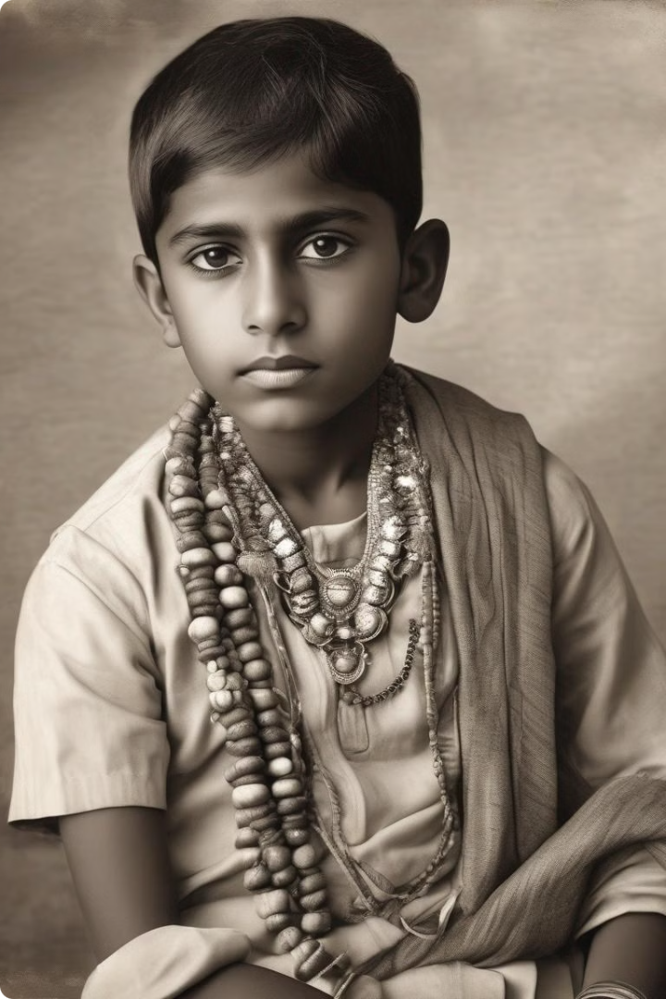
Overview of Purnwasi Bhujawan
Contract Number
QQ/766
Age
4
Religion/Caste
Ahir
Birthplace
British India, District: Gonakhpore, Village: Rasnepur

Slide 3
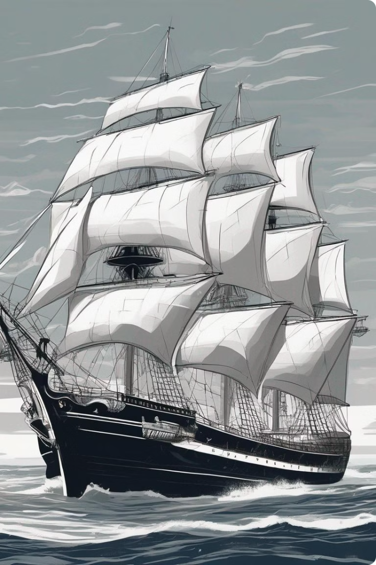
Purnwasi Bhujawan's Voyage
1
Ship Name
English SS. Sutlej III
2
Departure Point
Calcutta
3
Departure Date
25-11-1914

Slide 4
Work and Contract Details of Purnwasi Bhujawan
Planter
Plantation
Contract Start Date
M.Welle, Agent of Ned.Han.Mij, Delegate of Sur.Cult.Mij
Pl. Peperpot
7-1-1914
Contract End Date
Memo
7-1-1919
Changed name to Ramroep Boejhawan on Jan 16, 1954

Slide 5
Family Overview - Mother Pabitar Mahrajia
Contract Number
Religion/Caste
Memo
QQ/764
Ahirin
Insanity and children outsourced for care
First Name
Birthplace
Pabitar
British India, District: Gonakhpore, Village: Kochiha
Age
Contract Dates
25
7-1-1914 to 7-8-1921

Slide 6
Family Overview - Brother Saroan Purnwasi
Contract Number
Age
Religion/Caste
QQ/765
6
Ahir
Birthplace
Contract Start Date
Contract End Date
British India, District: Gonakhpore, Village: Kochiha
7-1-1914
7-1-1919
Memo
Passed away on April 10 at Margarethenburg

Slide 7
Caretakers - Ramrooch and Akali
Ramrooch
Akali
Contract Number: GG/123, Age: 35, Religion/Caste: Moorai, Birthplace: British India, District: Shahabad, Village: Ratanpura, Contract Dates: 14-12-1904 to 14-12-1909, Memo: Married Akali, caretaker of Saroan and Bhujawan
Contract Number: GG/124, Age: 24, Religion/Caste: Moorai, Birthplace: British India, District: Shahabad, Village: Ratanpur, Contract Dates: 14-12-1904 to 14-12-1909, Memo: Married Ramrooch, caretaker of Saroan and Bhujawan

Slide 8
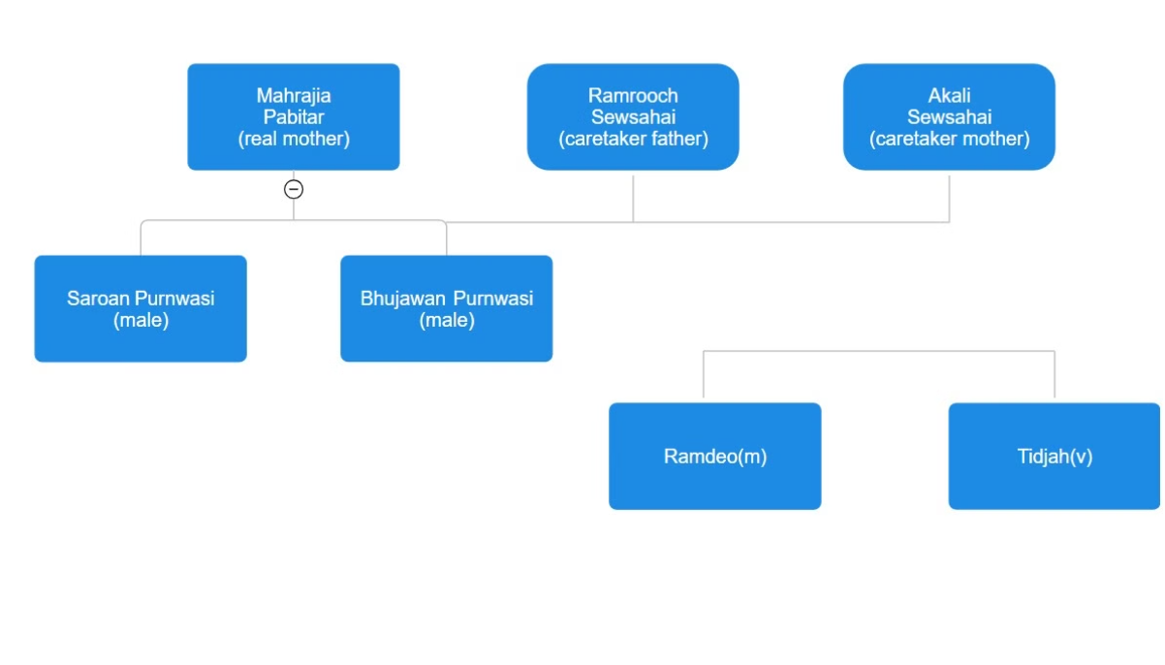
Visual Representation - Family Tree
Family Tree
A visual representation of the family lineage and connections.

Slide 9
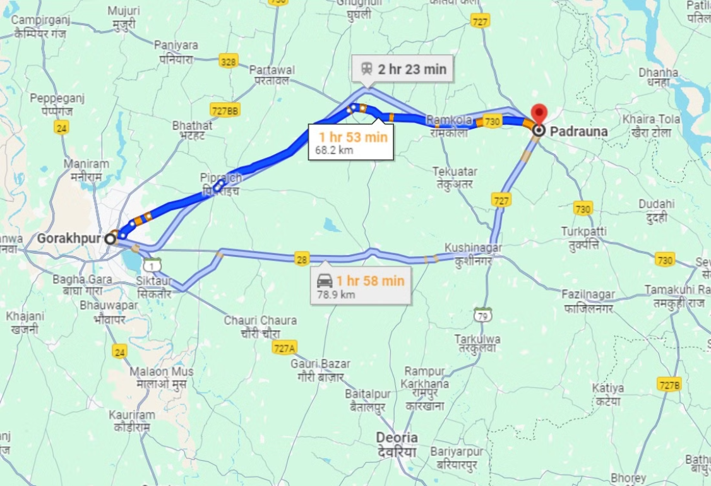
Visual Representation - Geographic Details
Geographic Details
A visual representation of the geographic details, including the distance from Gorakhpur village to the police station in Padrauna.

Slide 10

Conclusion
1
Thank you for your attention!
We hope this presentation has provided a comprehensive historical analysis of the contract workers from India to Suriname.

